Slide 1



INTRODUCTION TO
HEALTHVAULT
EMPOWERING WELLNESS, ONE PATIENT AT A TIME. YOUR HEALTH, OUR PRIORITY.

Slide 2

AGENDA
ABOUT US
HISTORY
OUR VISION
OUR MISSION
OUR SERVICES
FACILITIES
DOCTOR TEAM
GET IN TOUCH

Slide 3

ABOUT US
WELCOME TO HEALTHVAULT, YOUR DIGITAL SANCTUARY FOR COMPREHENSIVE HEALTHCARE MANAGEMENT. OUR INNOVATIVE PLATFORM EMPOWERS PATIENTS TO SECURELY STORE AND MANAGE ALL THEIR HEALTH-RELATED DOCUMENTS, FROM MEDICAL RECORDS AND TEST RESULTS TO PRESCRIPTION FILES AND WELLNESS PLANS. BY CREATING A PERSONALIZED ID, PATIENTS CAN EFFORTLESSLY ORGANIZE AND ACCESS THEIR HEALTH INFORMATION ANYTIME, ANYWHERE. ADDITIONALLY, HEALTHVAULT FACILITATES SEAMLESS COMMUNICATION BETWEEN PATIENTS AND HEALTHCARE PROVIDERS, ALLOWING DOCTORS TO SECURELY ACCESS PATIENT RECORDS THROUGH THEIR UNIQUE ID

Slide 4


OUR VISION
EMPOWERING HEALTH, TRANSFORMING LIVES: OUR VISION IS TO PIONEER A HEALTHIER FUTURE BY DELIVERING EXCEPTIONAL MEDICAL CARE WITH COMPASSION AND INNOVATION. WE ENVISION A COMMUNITY WHERE EVERY INDIVIDUAL RECEIVES PERSONALIZED, STATE-OF-THE-ART HEALTHCARE, FOSTERING WELL-BEING AND VITALITY. TOGETHER, WE STRIVE TO BE A BEACON OF HEALTH, CREATING A LASTING IMPACT ON LIVES AND INSPIRING A PARADIGM SHIFT IN HEALTHCARE EXCELLENCE.

Slide 5

OUR MISSION
INNOVATION IN HEALTHCARE SOLUTIONS:
EXCELLENCE IN PATIENT CARE:
STRIVING FOR MEDICAL EXCELLENCE TO ENSURE THE HIGHEST QUALITY OF CARE FOR EVERY PATIENT.
PRIORITISING THE COMFORT, DIGNITY, AND WELL-BEING OF THOSE WE SERVE.
EASE THE PAPER WORK OF PATIENTS AND DOCTORS BY ATTACHING THIER DOCUMENTS TO OUR WEBSITE.IT WILL EASE TO ACCESS PAST RECORDS OF PATIENTS.NOT ONLY THIS IT WILL ALSO HELP IN FRAUD DETECTION THROUGH PAST HISTORY DOCUMENTS.

Slide 6


OUR SERVICES
WE ARE DEDICATED TO PROVIDING COMPREHENSIVE HEALTHCARE SERVICES TAILORED TO MEET THE DIVERSE NEEDS OF OUR COMMUNITY. OUR SERVICES INCLUDE:
ROUTINE CHECK-UPS
PREVENTIVE CARE
VACCINATIONS
REPORTS MANAGEMENTS SYSTEMS
EXPERT CONSULTATIONS IN VARIOUS MEDICAL SPECIALTIES
ADVANCED DIAGNOSTIC SERVICS
CHAT AND APPOINTMENT FACILLITIES
24/7 EMERGENCY SERVICES
URGENT MEDICAL CARE
MEDICINE MANAGEMENT

Slide 7

FACILITIES
WE PRIDE OURSELVES ON PROVIDING A COMPREHENSIVE RANGE OF FACILITIES TO ENHANCE THE HEALTHCARE EXPERIENCE FOR OUR PATIENTS. OUR STATE-OF-THE-ART FACILITIES INCLUDE:
1.USER REGISTRATION AND PROFILE CREATION .
2.Document Upload and Storage .
3.Document Organization and Categorization .
4.Patient-Doctor Communication .
5.Feedback and Support .
6.Health Tracking and Monitoring .
7.Provide and overall heath condition .
AND MANY MORE......

Slide 8



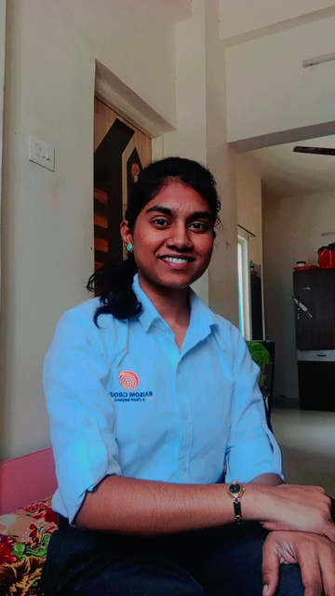
HEALHVAULT TEAM
MEET THE HEALING HEARTS AND BRILLIANT MINDS BEHIND OUR MEDICAL EXCELLENCE.
KESHAVSINGH THAKUR
PINKI GUPTA
HIMANSHU GUPTA
RIYA ANJIKAR
CEO
CO-FOUNDER
UI/UX DESIGNER
MARKETING TEAM

Slide 9

GET IN TOUCH
GET YOUR
HEALTHVAULT
TODAY
HEALTHVAULT673@GMAIL.COM
WWW.HEALTHVAULT.COM
PUNE , MAHARASHTRA , INDIA

Slide 10
THANK YOU
TEAM DATA DYNAMOS

